Slide 1

Using Microsoft Teams and OneDrive
Using Teams and OneDrive
Steven Buckner

Slide 2
Objectives
Understand the capabilities on Teams and OneDrive
Discover ways to utilize these applications
Become comfortable with each of the applications

Slide 3
Agenda
Current Environment
Introduction to Microsoft Teams
Features
Demo
Introduction to OneDrive for Business
Features
Demo
QA - Next steps

Slide 4
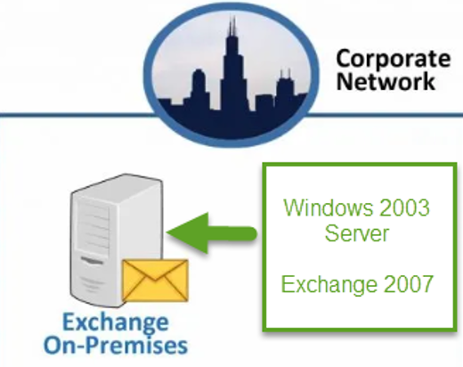
Old Environment

Slide 5

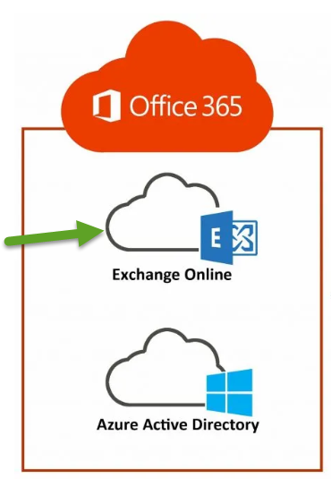



New Environment

Slide 6
Introduction to Teams

Slide 7
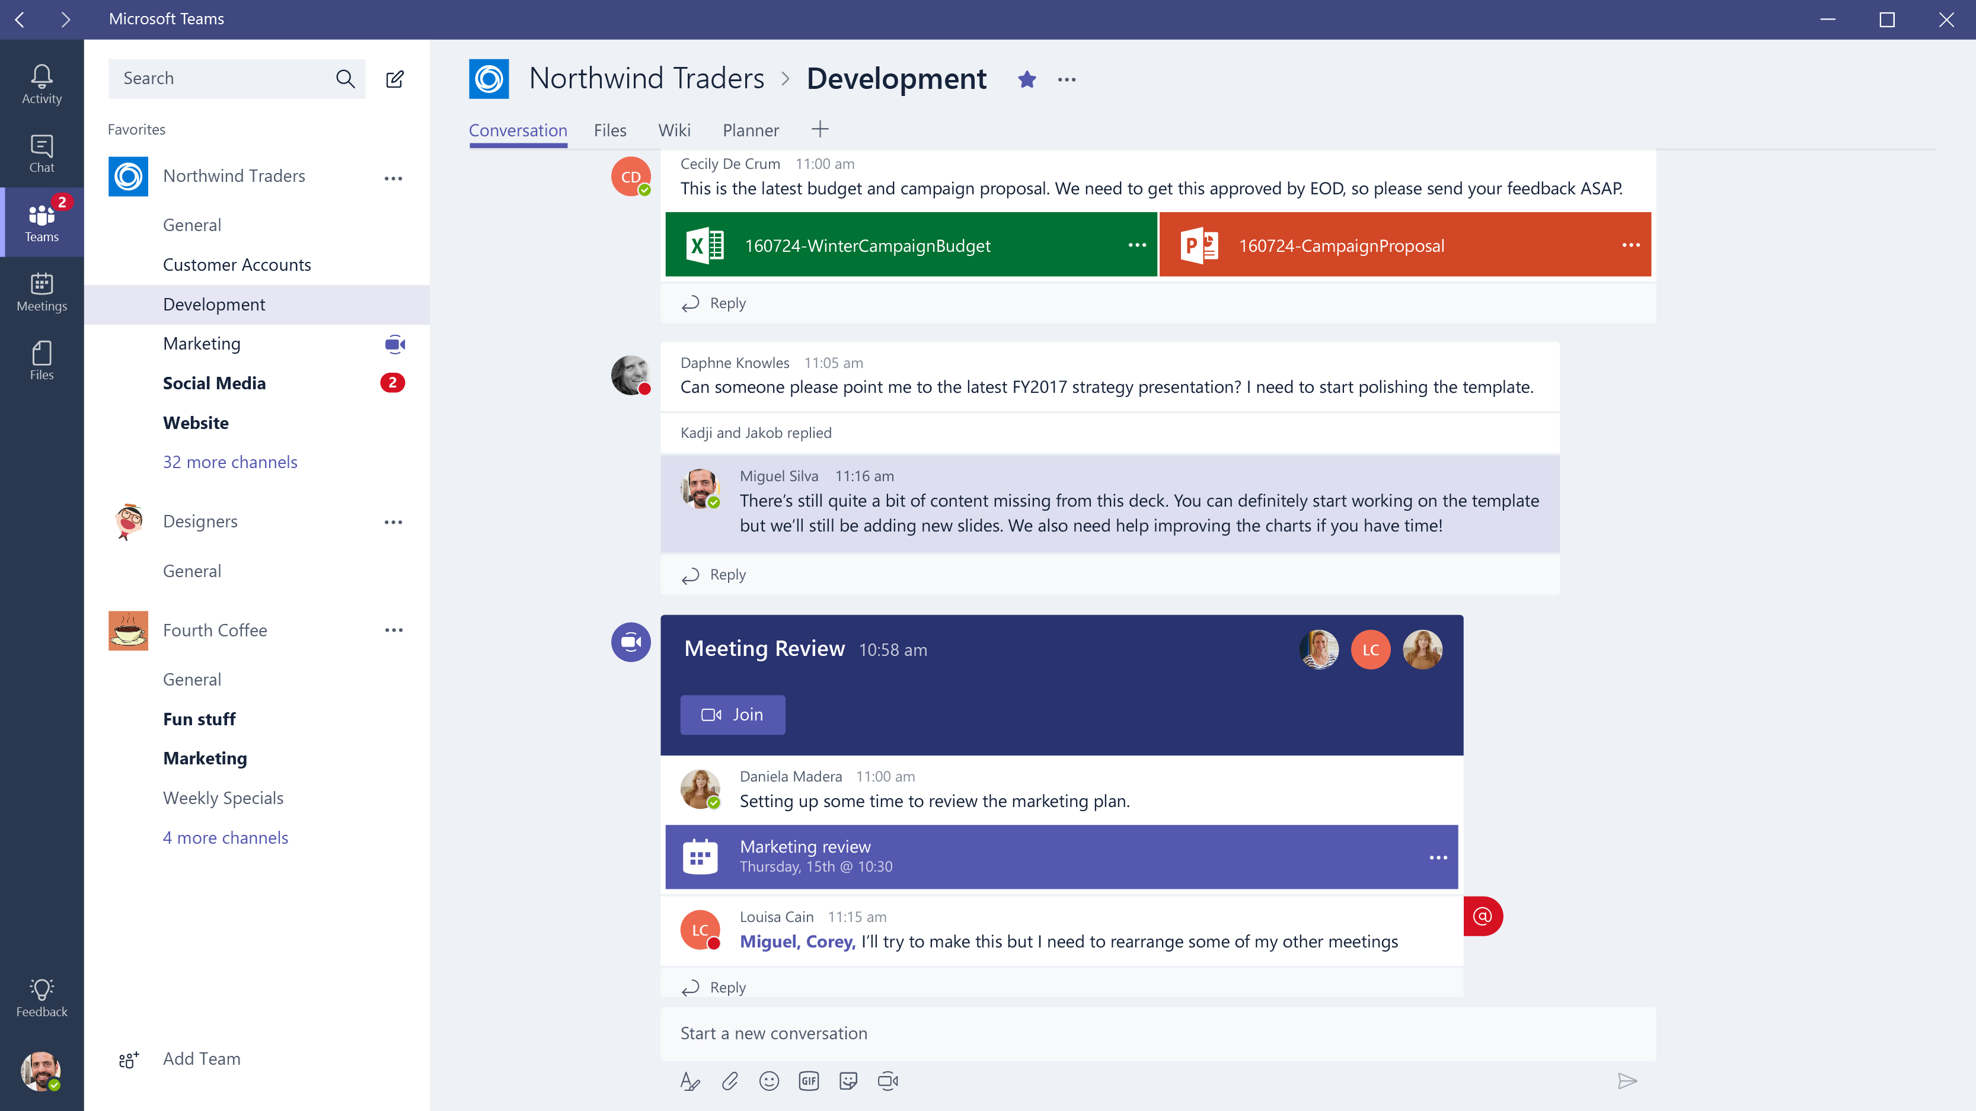
A hub for teamwork
Shared workspace where you can
Chat – 1-1 or Group Chat
Meet – Audio or Video
Screen Sharing
Share Files – Work together on built-in Office apps like Word, Excel, and PowerPoint

Slide 8

Microsoft Teams Demonstration

Slide 9
Introduction to OneDrive for Business

Slide 10
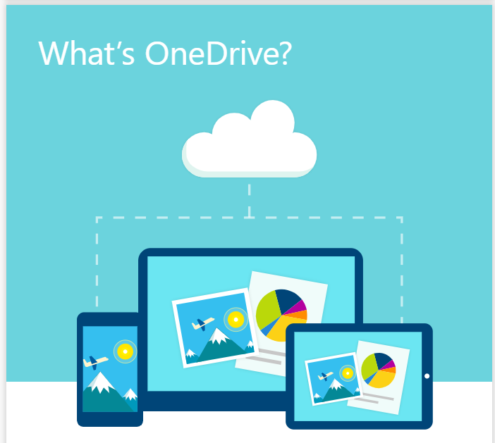
Cloud storage you can get from anywhere
PC or Mac
OneDrive.com
Phone or Tablet
Add, Edit, Share Files

Slide 11
Microsoft OneDrive Demonstration

Slide 12


Platform Requirements
Web
Desktop
Mobile
Edge: 12+
Internet Explorer: 11+
Chrome: 51.0+
Firefox: 47.0+
Safari (coming soon)
Windows 7+ (7, 8, 8.1, 10)
Both 32 & 64 bit available
Mac OSX 10.10+
Android 4.4+
iOS (iPhone and iPad) 10+
Windows Phone 10.0.10586+

Slide 13
Questions

